Slide 1




Slide 2


E-commerce, or electronic commerce, refers to the buying and selling of goods and services over the internet. It involves online transactions, electronic data exchange, and various electronic communication methods to conduct business.
Presented By: Snehal Malusare

Slide 3

IMPORTANCE
Strategic Edge:
Gain advantage by anticipating customer churn.
Proactively address concerns for retaining valuable customers.
Financial Implications:
Churn affects revenue; retaining customers is cost-effective.
Efficient resource allocation with prediction models maintains a healthy bottom line.
AIMS AND OBJECTIVES
Feature Exploration:
Identify pivotal features impacting customer attrition.
Algorithm Optimization:
Evaluate Logistic Regression, Decision Trees, and Random Forest.
Emphasize precision with comprehensive performance metrics.
Strategic Insights:
Formulate customer retention strategies based on analytical findings.

Slide 4

ABOUT THE DATASETS
Name: E-commerce Customer Behavior and Purchase Dataset
Source: The Datasets Sourced From Kaggle
Purpose: Crafted for data analysis and predictive modeling in the e-commerce domain.
Applications: Suitable for tasks like customer churn forecasting, market basket analysis, recommendation systems, and trend scrutiny.
Shape: 250000 Rows & 13 Features.

Slide 5

EXPLORATORY DATA ANALYSIS
EDA Highlights:
Analyzed distribution of each feature in the dataset.
Checked the correlation between features.
Visual Analysis:
Used visuals to gain insights into customer behavior.
Pinpointed factors contributing to churn.
Data Cleanliness
No duplicate values in the datasets.
The dataset contains 47382 null values.
Handling Null Values
Initially, 47382 NaN values were identified in the 'returns' column.
The 'returns' column contains values (0 and 1), where 0 means no returns and 1 means returns.
Decision: Filled NaN values with the mode value for better representation and interpretation.

Slide 6
Imbalance in Churn:
Retained: 79.95% (199,870)
Churn: 20.05% (50,130)
Pie chart illustration.
Males: 50.27%
Females: 49.73%
Pie chart breakdown.
Returned: 50.08%
Did not return: 49.92%
Includes null values.

Slide 7
The dataset reveals a well-balanced distribution in payment methods, with Credit Card, Cash, and PayPal each accounting for approximately 33.41%, 33.20%, and 33.37%, showcasing diverse customer usage patterns.
The dataset shows a balanced distribution among product categories, with Electronics at 25.05%, Books at 24.90%, Home at 25.02%, and Clothing at 25.03%.

Slide 8
The "Purchase Month" data from 2020 to 2024 shows:
Seasonal Peaks: Highest in January (22,882) and August (23,160).
Mid-Year Stability: Consistent counts in April (22,138) and June (22,132).
Year-End Uptick: Slight increase in December (17,234).
October & November Dip: Decreased activity in these months (17,051 and 16,690).
September Anomaly: Lower count in September (18,967) requires further investigation.
Over the four years (2020-2023), purchase patterns remained fairly consistent, with counts of 67,775 in 2020, 67,403 in 2021, and 67,585 in 2022. However, a significant decline to 47,237 in 2023 indicates a potential shift or change in purchasing behavior during that year.

Slide 9
Churn analysis by "Product Category" reveals overall customer loyalty.
Clothing and Electronics display consistent churn/retention.
Books and Home exhibit slightly higher churn, indicating areas for targeted retention strategies.
Churn analysis by "Payment Category" reveals credit card payments leading in retention (67,120) with the lowest churn (16,427). Cash and PayPal show similar churn and retention, indicating overall stability across payment methods.

Slide 10
Churn analysis by "Returns Feature" shows balanced churn and retention, with returns (20,240) and non-returns (20,504) having similar rates. This suggests that the return status alone does not significantly influence customer churn.
Churn analysis by "Gender" indicates almost equal churn counts for males (25,063) and females (25,067), with similar retention rates. Gender alone does not seem to be a significant factor in influencing customer churn.

Slide 11
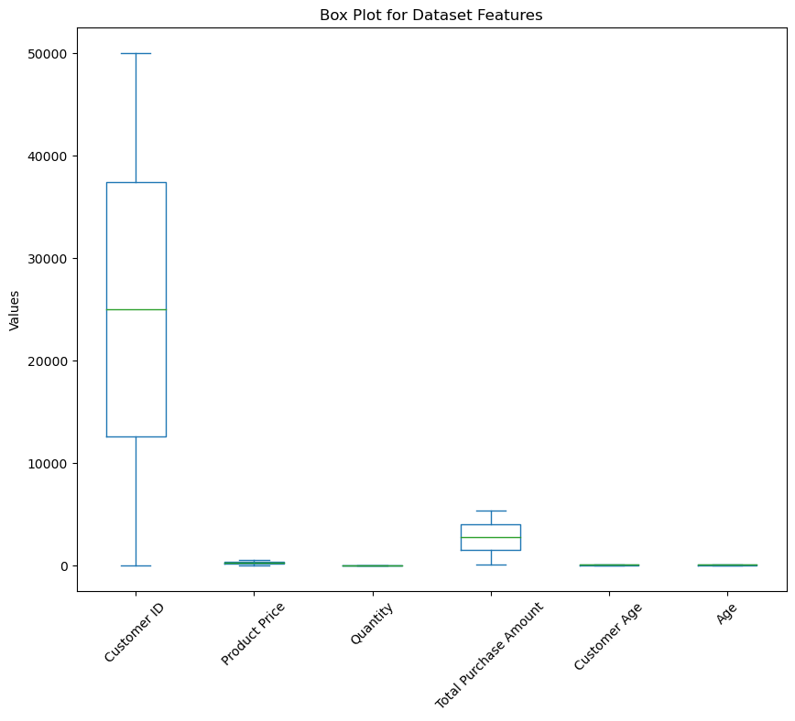
FROM ABOVE BOXPLOT WE OBSEREVED THAT:
The box plot analysis shows that all numerical features have a limited range of values without significant outliers. This suggests that there are no extreme values in the dataset.

Slide 12
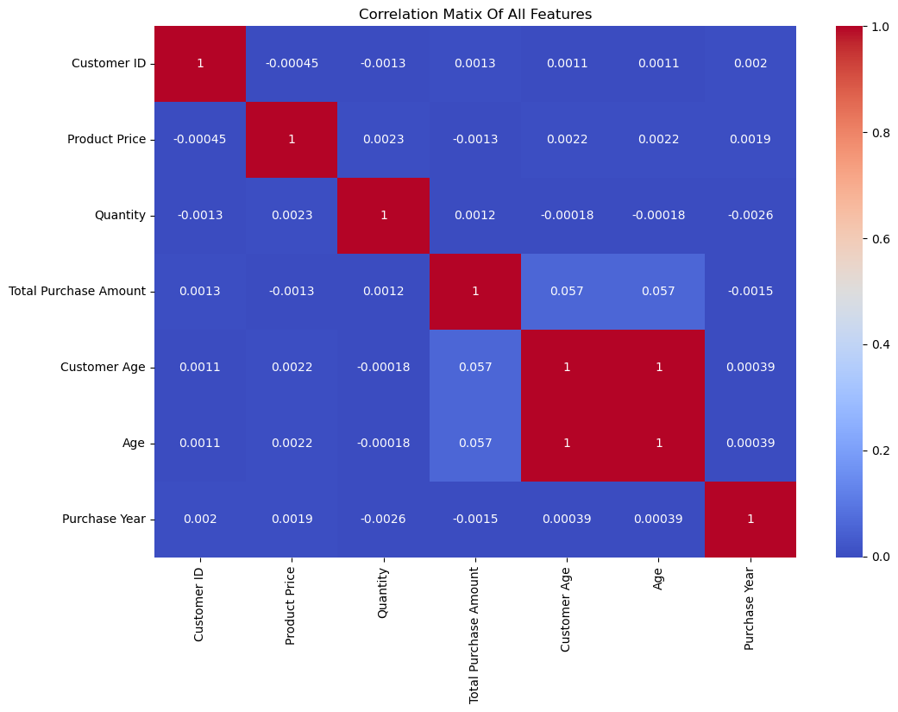
FROM ABOVE HEATMAP WE OBSEREVED THAT:
The heatmap indicates a high correlation between "Customer Age" and "Age," so I've decided to drop one of them, specifically "Age." Additionally, "Customer Age" and "Total Purchase Amount" show a correlation of 0.057, indicating a weak positive correlation.

Slide 13
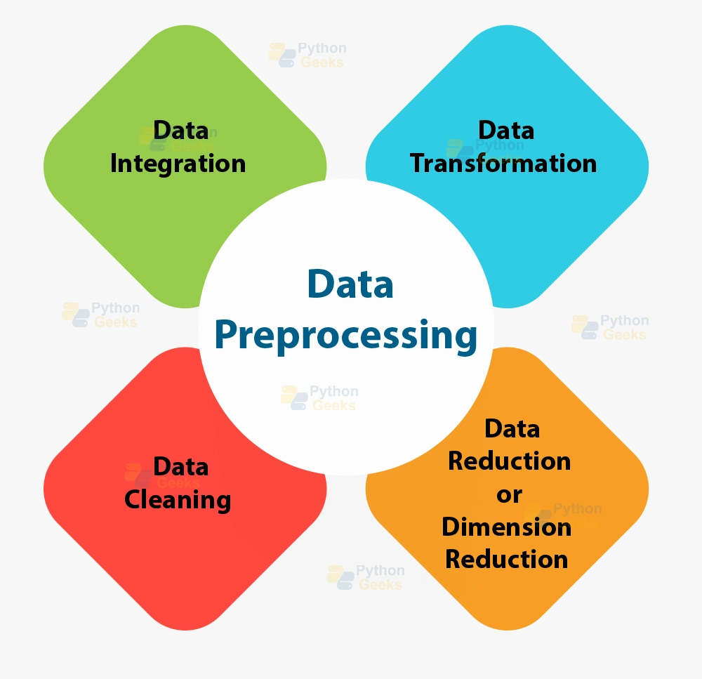
PREPROCESSING
Preprocessing is the step where we whip our data into shape. It involves handling missing values, dealing with outliers, and transforming features
Data Preparation Analogy:
It's like getting your ingredients ready before cooking a delicious meal!
Column Removal:
We can drop the "Customer ID","Purchase Date","Customer Name“because it doesn't provide useful information.And Highly Correlated Features"Age" column
Handling Null Values:
Use the “fillna() “ method to fill the null values with mode for columns 0 and 1 in “Returns” Columns
Label Encoding on Gender:
Use label encoding to convert categorical values in the "Gender" column into numerical values (0 and 1).
One-Hot Encoding for Product Category and Payment Method:
Use one-hot encoding to convert categorical values in the "Product Category" and "Payment Method" features into binary vectors.

Slide 14
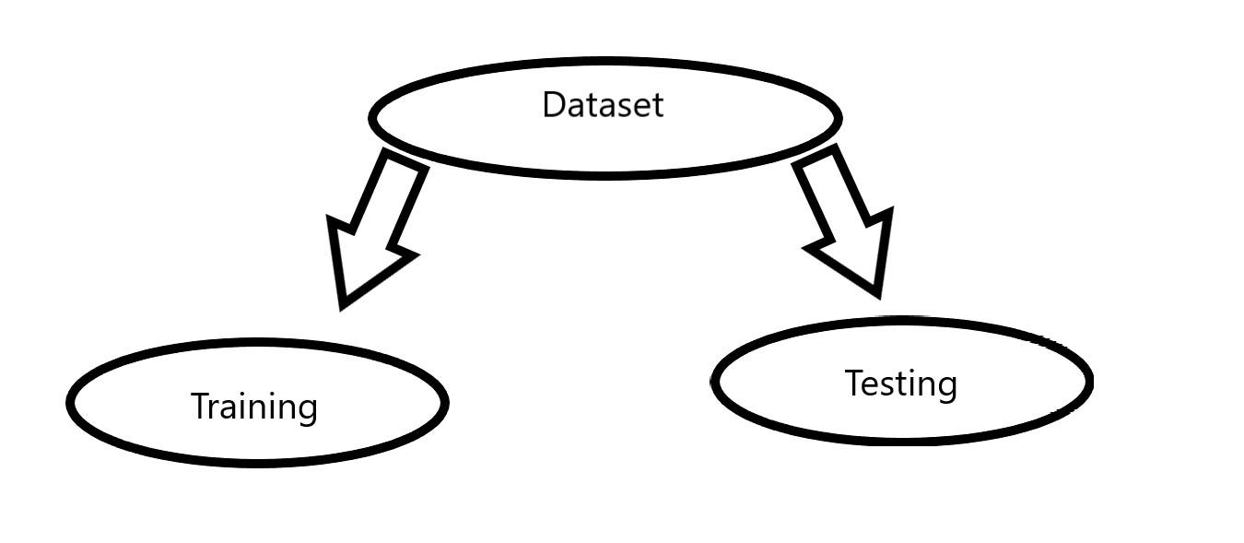
DATA SPLITTING
Data Splitting:
We divided the dataset into two parts: X and y.
Variable Representation:
"X" typically represents the independent variables.
"y" represents the dependent (target) variable we want to predict or understand.
TRAIN TEST SPLIT
Train-Test Split:
We divided the data into training (80%) and testing (20%) sets.
Consistency and Proportion:
Setting a random state of 123 ensures consistent results.
Using stratify=y maintains a proportional distribution of the target variable in both sets.

Slide 15


STANDARD SCALER
We used Standard Scaler to make sure anumeric features in the dataset have similar scales.
This consistency is important for certain machine learning methods.
It helps the models to perform better.
SMOTE TECHNIQUES
Over-sampling is a technique used in machine learning to address the class imbalance problem, especially in classification tasks with significant class disparities. This helps balance the class distribution.
Objective:
Improve model's ability to recognize minority class patterns.
SMOTE Technique:
Use SMOTE to generate synthetic samples for CHURNING
Result:
Both classes now equally distributed.
CHURNED= RETAINED=159896

Slide 16
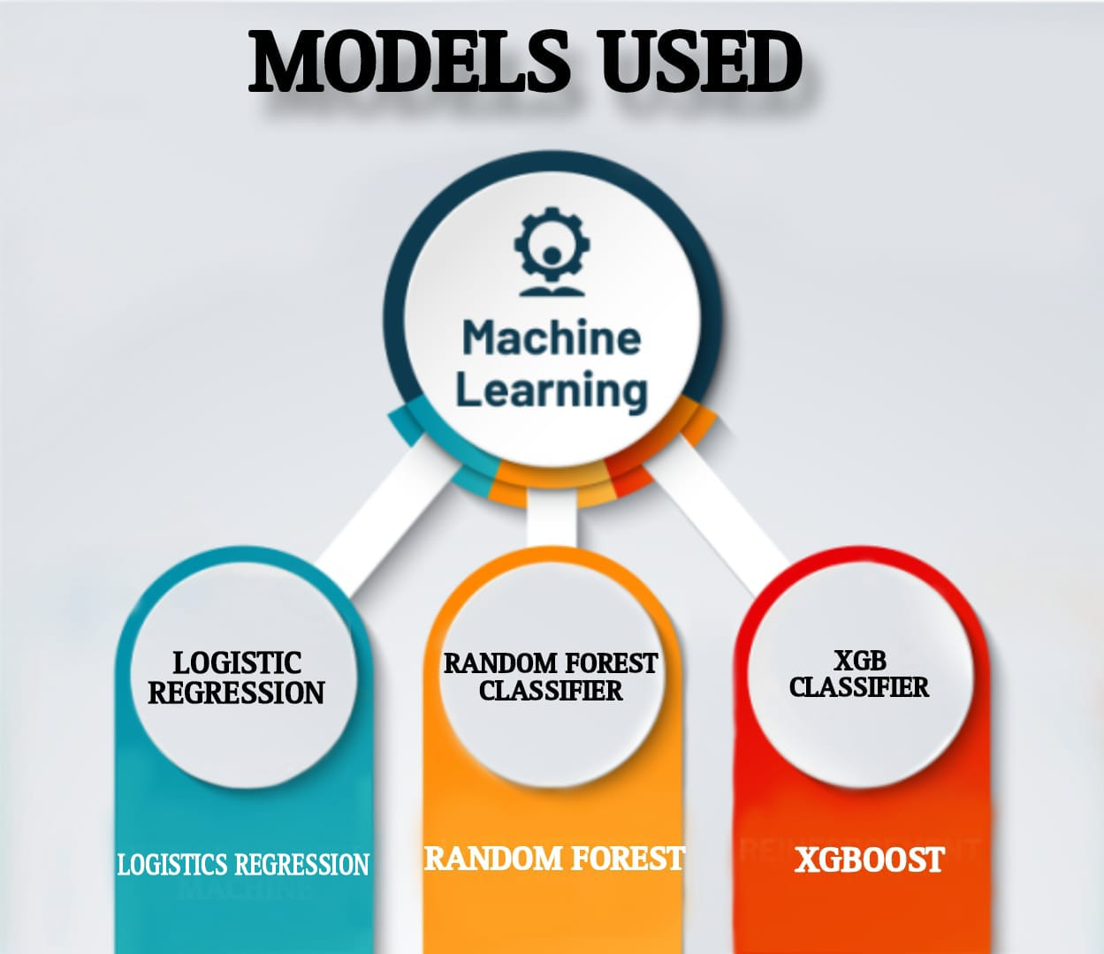
MODEL USED
Logistic Regression (LR)
Overview:
Primarily used for binary classification.
Predicts the probability of an instance belonging to a specific class.
Strengths:
Simplicity: Easy to understand and interpret.
Handling Imbalanced Data: Effective for datasets with imbalanced class distribution.
Random Forest
Overview
Robust ensemble method suitable for imbalanced datasets.
Strengths:
Handles non-linearity well.
Provides feature importance.
XGBoost
Overview:
Powerful gradient boosting algorithm.
Strengths:
Effective on imbalanced datasets.
Handles missing values.

Slide 17
MODEL COMPARISON
MODELS | ACCURACY | PRECISION | RECALL | F1 SCORE | ROC_AUC_SCORE
LOGISTIC REGRESSION | 0.5904% | 0.1999% | 0.3473% | 0.2538% | 0.4994%
RANDOM FOREST | 0.7181% | 0.1996% | 0.1347% | 0.1609% | 0.4996%
XGBOOST | 0.7944% | 0.2222% | 0.0099% | 0.0190% | 0.5006
AFTER HYPERPARAMETER TUNING
MODELS | ACCURACY | PRECISION | RECALL | F1 SCORE | ROC_AUC_SCORE
LOGISTIC REGRESSION | 0.5210% | 0.2020% | 0.4707% | 0.2827% | 0.5016%
RANDOM FOREST | 0.7127% | 0.2001% | 0.1444% | 0.1677% | 0.5017%
XGBOOST | 0.7967% | 0.2472% | 0.0066% | 0.0130% | 0.5033%
Challenge:
Accuracy can be misleading in imbalanced datasets, masking true performance on the minority class.
Metric Choice: ROC-AUC
Uses Receiver Operating Characteristic - Area Under the Curve.
Evaluates the model's ability to distinguish positive and negative classes.
Robust against uneven class distribution.
Outcome:
XGBoost stands out with the highest ROC-AUC after Hyperparameter tuning score of.0.5033%
Performance Comparison:
Logistic regression and Random Forest have respectable scores (0.5016% and 0.5017% respectively).
However, they fall short of XGBoost performance.
Decision:
Choosing XGBoost is justified for its robust performance in this binary classification task.

Slide 18
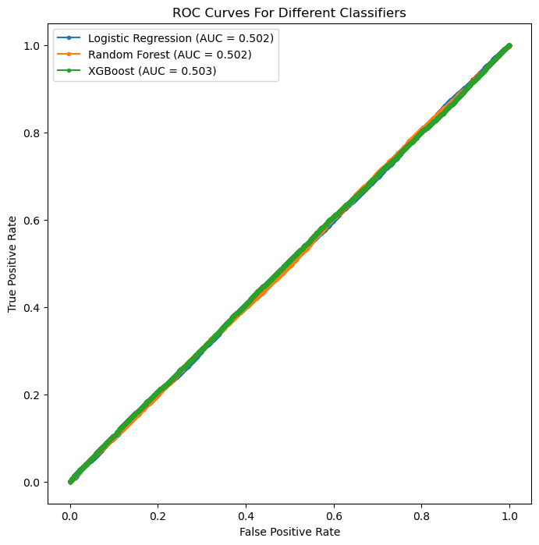
ROC-AUC CURVES
Graph showing the model's skill in making this separation.
XGBOOST:
Highest ROC-AUC:0.5033%
LOGISTIC REGRESSION and RANDOM FOREST:
Respectable scores (0.5016% and 0.5017%).
Fall short of XGBoost.
Decision:
Choosing XGBoost is justified for its robust performance After Hyperparameter Tuning.

Slide 19

CONCLUSION
Data Overview:
250K rows, 13 numeric features.
Churn: 20.05%, Retention: 79.95%.
Distributions:
Product, Payment, Quantity, Gender: Balanced.
Trends:
Balanced returns.
Peaks: Jan, Aug. Stable mid-year. Uptick year-end. Oddities in Sept.
Modeling:
Logistic Regression, Random Forest, XGBoost.
Winner: XGBoost after tuning.
Preprocessing:
Date conversion, encoding, nulls filled with mode.
Dropped irrelevant, scaled numeric features.
Balanced with SMOTE.
Conclusion:
Data ready.
XGBoost excels.

Slide 20


